Slide 1



DATA ENCRYPTION
TEAM MEMBERS : A.PRANUSHA
D.MADHU SRI
O.SREEJA
GUIDE : I.GOVARDHAN RAO

Slide 2
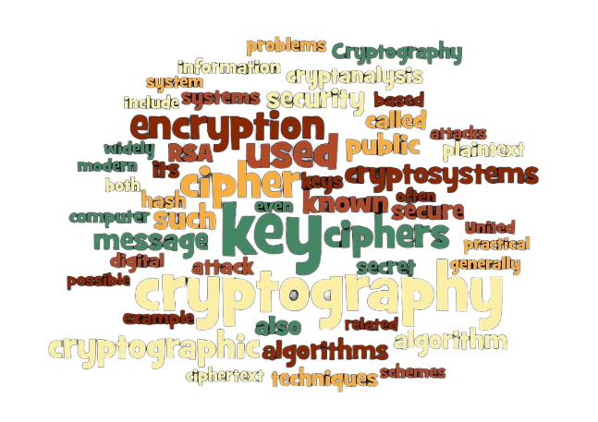
INTRODUCTION
Data Encryption is a method of preserving data confidentiality by transforming it into ciphertext, which can only be decoded using a unique decryption key produced at the time of the encryption or before it. The conversion of plaintext into ciphertext is known as encryption.
Depending on the use case, there are a variety of data encryption algorithms to choose from, but the following are the most commonly used:

Slide 3
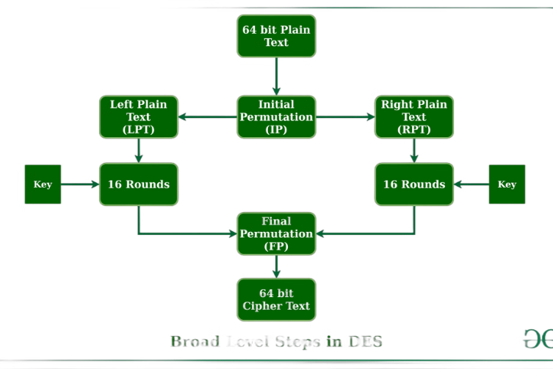
DES (Data Encryption Standard)
DES is a symmetric-key algorithm that was once the most widely used method for encrypting data. It was developed in the 1970s by IBM
DES is a block cipher and encrypts data in blocks of size of 64 bits each, which means 64 bits of plain text go as the input to DES, which produces 64 bits of ciphertext. DES encrypts and decrypts data in 64-bit blocks using a 56-bit key. Its simple, iterative structure makes it fast and efficient, but also vulnerable to brute-force attacks as computing power has increased over time.

Slide 4
Numerical Detail Example
1.Plaintext
2.Key
3.Encryption
4.Encryption
The plaintext is represented as a 64-bit block. For example, the ASCII text "hello" can be represented as 01101000 01100101 01101100 01101100 01101111
The key is also represented as a 64-bit block, with 56 bits being used for encryption. For example, a key might be represented as 01010000 00001111 00000000 00001001
The encryption process involves applying various operations, including substitution, permutation, and XOR, to the plaintext block using the subkeys generated from the original key.
The encryption process involves applying various operations, including substitution, permutation, and XOR, to the plaintext block using the subkeys generated from the original key.

Slide 5
Formula with Simple Examples
Permutation
Substitution
XOR Operation
Permutations are used to rearrange bits. For example, the initial permutation (IP) is defined by a table that specifies the new order of bits.
Substitution involves replacing a group of bits with another group using a lookup table called an S-box. Each S-box has a specific input size and output size.
The XOR operation is used to combine bits. For example, the XOR of 0110 and 1011 is 1101.
0110 XOR 1011 = 1101
IP(1, 2, 3, 4, 5, 6, 7, 8, ...) = (58, 50, 42, 34, ...)
S-box(001011) = 100101

Slide 6
Detailed Numerical Example
1
Plaintext
The plaintext is "hello world", which is padded and converted to binary: 01101000 01100101 01101100 01101100 01101111 00100000 01110111 01101111 01110010 01101100 01100100 00100000 00000101 00000101 00000101 00000101.
2
Key
The key is "secretkey123", which is also converted to binary. This binary key is then used to generate 16 subkeys, each 48 bits long.
3
Initial Permutation (IP)
The plaintext is permuted according to the IP table. The permuted bits are then divided into two halves, L0 and R0.
4
Round 1 to 16
Each round involves expansion, substitution, permutation, and XOR operations using the subkeys. L0 and R0 are transformed into L1 and R1. The process repeats for 16 rounds
5
Final Permutation (FP)
The final output of the 16 rounds, L16 and R16, are combined and then permuted according to the FP table, producing the ciphertext.

Slide 7
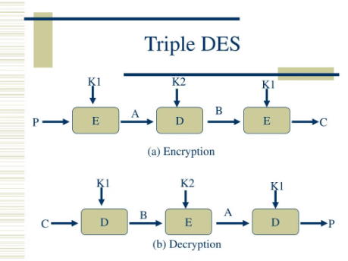
TRIPLE DES
Overview
Key Structure
Encryption Process
Triple DES, also known as 3DES, is a symmetric-key cryptographic algorithm that enhances the security of the original Data Encryption Standard (DES) by applying the DES algorithm three times. It was developed to address the weaknesses of DES and provide stronger encryption.
Triple DES uses three 56-bit keys, resulting in an effective key length of 168 bits. The three keys are applied in succession: encryption, decryption, and then encryption again, providing increased resistance to brute-force attacks.
The Triple DES encryption process involves three rounds of DES encryption, using the three different keys. This approach significantly improves the security compared to the original DES algorithm, as it makes it much more difficult for attackers to recover the plaintext.

Slide 8
3DES ALGORITHM
3DES Encryption Formula
3DES uses three 56-bit DES keys, usually referred to as K1K_1K1​, K2K_2K2​, and K3K_3K3​. The plaintext block PPP is encrypted in the following manner:
C=EK3​​(DK2​​(EK1​​(P)))
Where:
E represents DES encryption.
D represents DES decryption.
P is the plaintext.
C is the ciphertext.
3DES Decryption Formula
The decryption process is the reverse of encryption:
P=DK1​​(EK2​​(DK3​​(C)))

Slide 9
NUMERICAL EXAMPLE
Let's take a simplified example with arbitrary keys and plaintext to understand the process.
Step-by-Step Example
1
Choose Keys and Plaintext:
2
First Encryption (with K1​):
K1=0x0123456789ABCDEFK_1
Encrypt plaintext P with key K1:
K2=0x23456789ABCDEF01K_2
C1=EK1(P)
K3=0x456789ABCDEF0123K_3
Suppose this results in: C1=0x85E813540F0AB405
P=0x0123456789ABCDEF (Example plaintext)
3
Second Decryption (with K2​):
4
Third Encryption (with K3​):
Decrypt the result C1 with key K2​:
Encrypt the result C2 with key K3​: C=EK3(C2)
C2=DK2(C1)
Suppose this results in: C2=0x29C3505F571420F6
Suppose this results in: C=0xDE82A5F57B5B5479
5
Ciphertext:
The final ciphertext C is:
C=0xDE82A5F57B5B5479

Slide 10
Verification by decryption:
To verify, decrypt the ciphertext C back to the plaintext P using the reverse process:
1
First Decryption (K3​):
C2′=DK3(C)
C2′=0x29C3505F571420F6
2
Second Encryption (with K2​):
C1′=EK2(C2′)
C1′=0x85E813540F0AB405
3
Third Decryption (with K1​):
P′=DK1(C1′)
P′=0x0123456789ABCDEF
The decrypted plaintext P′ matches the original plaintext P, verifying the correctness of the encryption and decryption process.

Slide 11
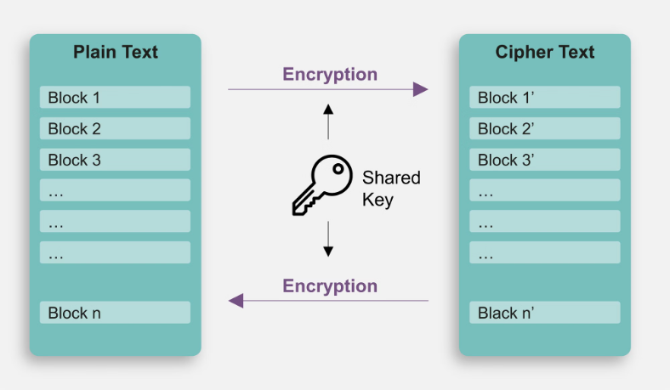
AES
AES (Advanced Encryption Standard) is a widely adopted symmetric-key cryptographic algorithm. It is a block cipher that operates on 128-bit data blocks, with key sizes of 128, 192, or 256 bits. AES is known for its high security, efficiency, and widespread use in various applications.

Slide 12
AES Algorithm:
Parameters:
Plaintext (P): 00112233445566778899aabbccddeeff
Key (K): 000102030405060708090a0b0c0d0e0f
Key Expansion
Key Expansion generates round keys from the original key.
Example Round Keys:
Round Key 0 (initial key): 000102030405060708090a0b0c0d0e0f
Round Key 1: d6aa74fdd2af72fadaa678f1d6ab76fe
Round Key 2: b692cf0b643dbdf1be9bc5006830b3fe
…up to Round Key 10.

Slide 13
Initial Round
Step 1: AddRoundKey
AddRoundKey involves XORing the plaintext with the first round key.
State=P⊕Round Key 0
Initial State (XOR with Round Key 0): 00112233445566778899aabbccddeeff⊕000102030405060708090a0b0c0d0e0f=00102030405060708090a0b0c0d0e0f0
Main Rounds (1-9)
Each round consists of four steps: SubBytes, ShiftRows, MixColumns, and AddRoundKey.
Round 1 Example:
1.SubBytes
Apply the S-box substitution for each byte in the state.
Simplified Example: State=63cab7040953d051cd60e18c
2.ShiftRows
Perform a left cyclic shift on each row.
Simplified Example:State=6353e08c0960e104cd70b751bad051e7
3.MixColumns
Mix columns by matrix multiplication in GF(2^8).
Simplified Example: State=5f72641557f5bc92f7be3b291db9f91a
4.AddRoundKey
XOR the state with the round key.
SimplifiedExample:State=5f72641557f5bc92f7be3b291db9f91a⊕d6aa74fdd2af72fadaa678f1d6ab76fe=89d810e8855ace682d1843d8cb128fe4
This process is repeated for rounds 2-10, each with unique round keys.
Ciphertext (C)
The final state after the 10th round is the ciphertext: C=33274411e36dc66b91f1f5962a9509e2

Slide 14
AES Decryption
Decryption follows the reverse process of encryption, starting from the final ciphertext and using the inverse operations in reverse order.
Steps:
Initial AddRoundKey
Inverse ShiftRows
Inverse SubBytes
AddRoundKey
Inverse MixColumns
For the last round, omit the Inverse MixColumns step.

Slide 15
Decryption Example (simplified for Round 10):
1.AddRoundKey State=33274411e36dc66b91f1f5962a9509e2⊕13111d7fe3944a17f307a78b4d2b30c5=20cf5d2ea842d1a6bc78d86e1d0f79e6
2.Inverse ShiftRows
State=20cf5d2ea842d1a6bc78d86e1d0f79e6
3.Inverse SubBytes
State=89d810e8855ace682d1843d8cb128fe4
This process continues through all the rounds until the original plaintext is retrieved.
Final Plaintext
P=00112233445566778899aabbccddeeff

Slide 16





Encryption and Decryption Processes
Plaintext Input
The process begins with the original data or message, known as the plaintext, which needs to be secured.
Key Generation
A secret key is generated, which will be used to encrypt and decrypt the data. The key must be kept secure.
Encryption
The plaintext is transformed into an unreadable format called ciphertext using the encryption algorithm and the secret key.
Transmission
The ciphertext is transmitted or stored, ensuring the data remains secure during transport or storage.
Decryption
The ciphertext is transformed back into the original plaintext using the same secret key and the decryption algorithm.

Slide 17
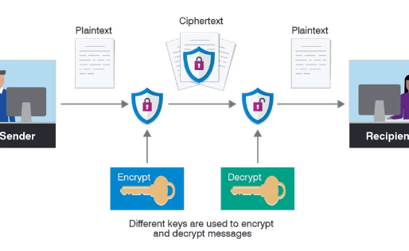
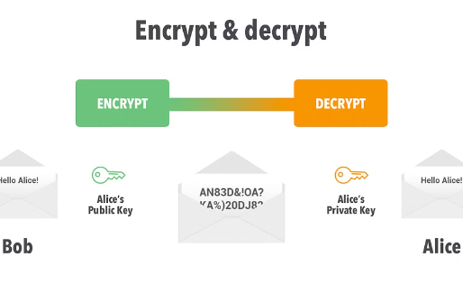
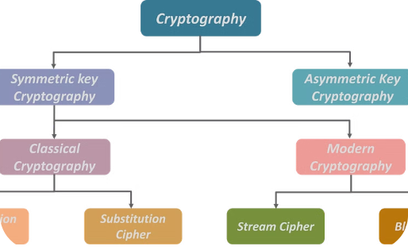
Image Encryption and Decryption
Encryption Process
Decryption Process
Cryptographic Algorithms
The image encryption process converts the original image data into an unreadable format using a cryptographic algorithm and a secret key. This protects the image content from unauthorized access or tampering.
The decryption process reverses the encryption, restoring the original image data from the encrypted form. This requires the same secret key used for encryption, ensuring only authorized parties can access the image content.
Commonly used algorithms for image encryption include DES, Triple DES, and AES. These algorithms apply complex mathematical transformations to the image data, providing strong protection against unauthorized access and data manipulation.

Slide 18
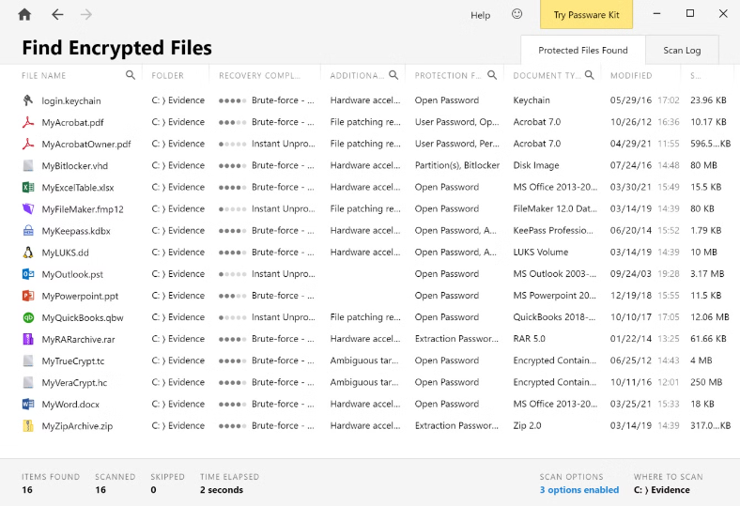
Video Encryption and Decryption
Video encryption is a critical process to secure confidential video content during transmission and storage. It involves converting the original video data into an unreadable format using cryptographic algorithms like DES, Triple DES, and AES.
The encrypted video can only be accessed by authorized parties with the correct decryption key. This protects the video from unauthorized access, tampering, and eavesdropping.

Slide 19

Text Encryption and Decryption
The encryption and decryption of text data is a critical component of secure communication. Various cryptographic algorithms, such as DES, Triple DES, and AES, provide robust protection for confidential text messages by transforming the plaintext into ciphertext that is unreadable to unauthorized parties.
These algorithms leverage complex mathematical functions and keys to ensure the security of the text data, enabling the intended recipient to decrypt the message and access the original content. The performance of these algorithms is evaluated based on factors like encryption/decryption speed, key size, and computational complexity.

Slide 20
Performance Evaluation Metrics
To evaluate the performance of cryptography algorithms like DES, Triple DES, and AES, key metrics are considered. These include encryption and decryption time, key strength, memory usage, and energy consumption. Factors like data size, hardware specifications, and attack resistance are also evaluated.
Metric
Description
Encryption Time
The time taken to convert plaintext to ciphertext.
Decryption Time
The time taken to convert ciphertext back to plaintext.
Key Strength
The number of possible keys and resistance to brute-force attacks.
Memory Usage
The amount of RAM required to perform encryption/decryption.
Energy Consumption
The power required to run the encryption/decryption process.
These metrics help determine the efficiency, security, and practicality of each algorithm for different applications involving images, videos, and text data.

Slide 21
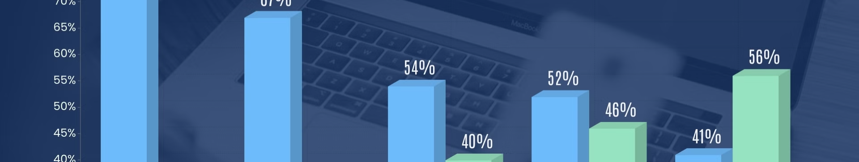
Security Strength and Resistance to Attacks for DES
Short Key Length
Weak Cryptographic Design
Declining Computational Power
The DES algorithm has been shown to have weaknesses in its internal structure, making it susceptible to differential and linear cryptanalysis attacks.
As computing power has increased exponentially, the effort required to break DES has become more feasible, reducing its overall security strength over time.
DES has a relatively short 56bit key length, making it vulnerable to brute-force attacks that can try all possible key combinations

Slide 22
Security Strength and Resistance to Attacks for triple DES
Enhanced Security
Resistance to Brute Force
Crypto analysis Challenges
Triple DES provides stronger encryption than the original DES by applying the DES algorithm three times with three different keys.
The increased key length of triple DES (168-bit) makes brute force attacks significantly more difficult compared to DES (56-bit).
Advances in cryptanalysis have uncovered some weaknesses in triple DES, but it remains a secure and widely-used encryption standard.

Slide 23
Security Strength and Resistance to Attacks for AES
Cryptographic Strength
Side-Channel Resilience
Computational Complexity
AES is an advanced encryption standard with strong cryptographic properties. The algorithm uses a 128-bit, 192-bit, or 256-bit key size, providing high levels of security against brute-force attacks.
AES has been designed with measures to protect against side-channel attacks, such as timing attacks and power analysis. This makes it more secure for use in sensitive applications.
The computational complexity of AES is relatively low, allowing for efficient hardware and software implementations. This makes AES a versatile and practical encryption solution.

Slide 24
Comparative Analysis of Algorithms
Key Attributes
Security Strength
Processing Speed
Energy Efficiency
When comparing DES, Triple DES, and AES, we'll examine factors like block size, key length, and the number of rounds in the encryption process.
AES is considered the most secure, with its 128/192/256-bit key lengths providing stronger protection against brute-force attacks compared to the 56-bit keys of DES.
AES is the fastest, with hardware implementations achieving impressive speeds. Triple DES is significantly slower due to its 3-round structure.
The simpler structure of AES makes it more power-efficient, an important factor for mobile and IoT devices. DES and Triple DES require more computational resources.

Slide 25
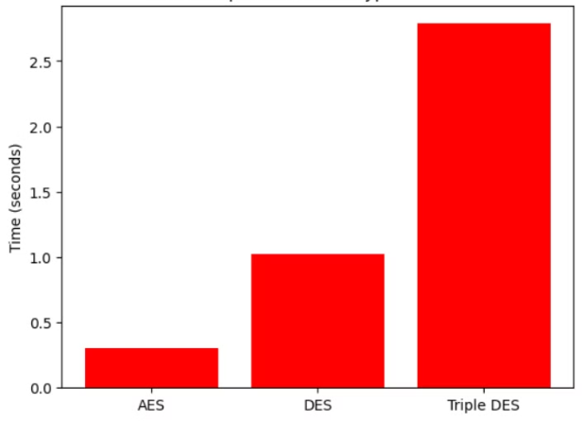
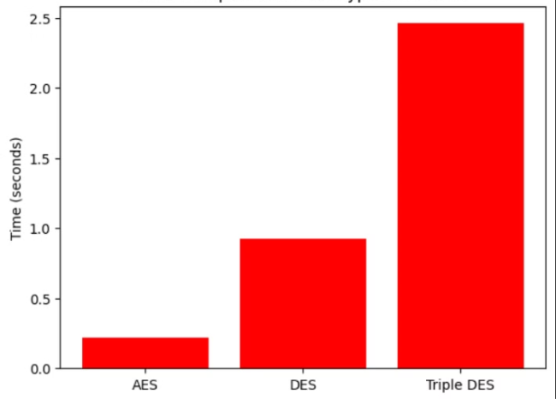
Analysis OF AES, DES & TRIPLE DES :
Time Comparison for decryption
Time Comparison for encryption

Slide 26
Computational Complexity and Resource Usage
Time Complexity
Memory Requirements
Hardware Acceleration
Energy Efficiency
DES, Triple DES, and AES have varying degrees of computational complexity, affecting the time required for encryption and decryption operations.
The algorithms have different memory footprints, with AES generally requiring more memory than DES or Triple DES for key storage and intermediate computations.
The energy consumption of the algorithms varies, with AES generally being more efficient than DES or Triple DES, especially on mobile and embedded devices.
Specialized hardware like dedicated crypto processors can significantly improve the performance of these algorithms, reducing computational overhead.

Slide 27
Strengths and Weaknesses of Algorithms
Strengths of DES
Strengths of Triple DES
DES is a well-established and widely-used algorithm with a strong cryptographic foundation. It is computationally efficient and can be implemented in hardware for high-speed encryption.
Triple DES offers increased security by using a longer key length and multiple encryption rounds. It is a reliable and secure option for applications that require higher levels of protection.
Strengths of AES
Weaknesses of DES
AES is a modern, flexible algorithm with variable key sizes and proven resistance to cryptanalysis. It is highly efficient, both in software and hardware implementations, making it suitable for a wide range of applications.
DES has a relatively short key length, making it vulnerable to brute-force attacks. It is also susceptible to cryptanalytic techniques, such as differential and linear cryptanalysis.

Slide 28
Applications for DES, Triple DES, and AES
Data Encryption for Sensitive Information
Secure Communications
Disk Encryption and Data Storage Security
Wireless and Mobile Security
These algorithms are essential for establishing secure communication channels, ensuring the confidentiality of messages exchanged over networks, and preventing eavesdropping.
These encryption algorithms are vital for securing wireless networks, mobile devices, and internet-connected IoT (Internet of Things) devices to prevent unauthorized access and data theft.
DES, Triple DES, and AES are widely used to protect sensitive data like financial transactions, medical records, and government communications from unauthorized access and tampering
DES, Triple DES, and AES are commonly used to encrypt data stored on hard drives, flash drives, and other storage media to safeguard against data breaches.

Slide 29

Conclusion and Recommendations
In conclusion, the performance evaluation of DES, Triple DES, and AES algorithms has shown their unique strengths and weaknesses for encrypting and decrypting different types of data. The choice of algorithm should be based on the specific requirements of the application, including security needs, computational resources, and performance requirements.

Slide 30
REFERENCES
1.https://ieeexplore.ieee.org/document/9012536 – Performance Evaluation for DES and AES Algorithms- An Comprehensive Overview.
2.https://ieeexplore.ieee.org/document/9609738 – Image Data Encryption Using DES Method

